Slide 1

Water Quality Predictor and Usage Suggestor
Vivekanand Education Society’s Institute of Technology
Department of Artificial Intelligence and Data Science
Group 7
Team Members
Parth Suryavanshi
Shreya Singh
Shruti Devlekar
Yash Sarang
Mentor
Dr. Anjali Yeole
Sustainability Goals Targeted :
Clean Water and Sanitation
Good Health and Well Being

Slide 2
Our Problem Statement:
Creating a Water Quality Prediction Application,
which will further define the suitability which would help us in suggesting in the use cases of the available water.
i.e
Suitable for Drinking,
Suitable for Agriculture(with high mineral levels),
Suitable for Industry level usage(Hardness, Turbidity),
Suitable for induction(Conductivity)

Slide 3
Introduction
Access to safe drinking-water is essential to health, a basic human right and a component of effective policy for health protection.
health and development issue at a national, regional and local level.
The bulk of the world's water use is for agriculture, industry, and electricity.
Our project aims to prepare a Model to suggest the perfect use case of any water body, or storage of water by predict the quality of water using factors like hardness, pH value, dissolved solids, chloramines, sulfate, carbon, etc and tell us the purity of water, its features and attributes.

Slide 4
Literature Survey
During the literature survey, we learned the basis of the water quality model, water quality standards, big data water quality analysis and different Machine Learning algorithms including Decision Tree Model, Artificial Neural Networks and Improved Decision Tree Model.
Two classes of water quality evaluation : a) Single factor based methods. b) Comprehensive index based methods.
Water quality model : These models describe the main water quality processes and typically require the hydrological and constituent inputs.
Water quality standards : The first step in water quality evaluation is to decide quality standards for a water body based on the desired uses of the water body. The quality standards will be different based on the use cases.
Big data water quality analysis : Nowadays, big data solutions have become efficient and receive more attention. Key to making big data actionable is harnessing, standardizing, and integrating the enormous amount of data.

Slide 5
Literature Survey(continued)
Different Machine Learning Algorithms Studied -
Decision Tree Model - It is a supervised learning technique which uses a predictive model to map observations about an item (represented in the branches) to conclusions about the item's target value (represented in the leaves).
Artificial Neural Networks - Tries to simulate the structures and networks within the human brain. It consists of nodes which generate a signal or remain silent as per a sigmoid activation function in most cases. The ANN model has the ability to efficiently describe the non-linear relationship of the complex water quality datasets.
Improved Decision Tree Model - This model combines artificial neural networks and decision tree algorithms. The main advantage of this approach lies in the clustering of data when processing the data with stress on inter-dependency between parameters and an aim at reducing rough disadvantages at the same time. Therefore, more accurate predictions can be made by using this method.

Slide 6
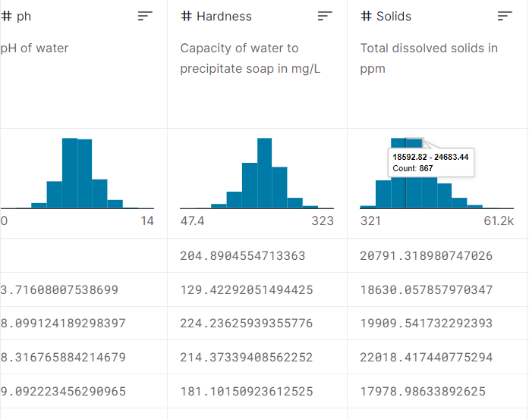
Dataset
Our dataset would include the water properties of
1. pH value
2. Hardness
3. Solids (Total dissolved solids - TDS)
4. Chloramines
5. Sulfate
6. Conductivity
7. Organic_carbon
8. Trihalomethanes
9. Turbidity
10. Potability

Slide 7
Flow of the Project:
Preparing the data (pre-processing)
Training the Model - feeding the data to the model
Model Optimization - parameter tuning and optimization
Testing the model using real world data
Creating an Application for users.
Integrating the Model into the Web Application.

Slide 8
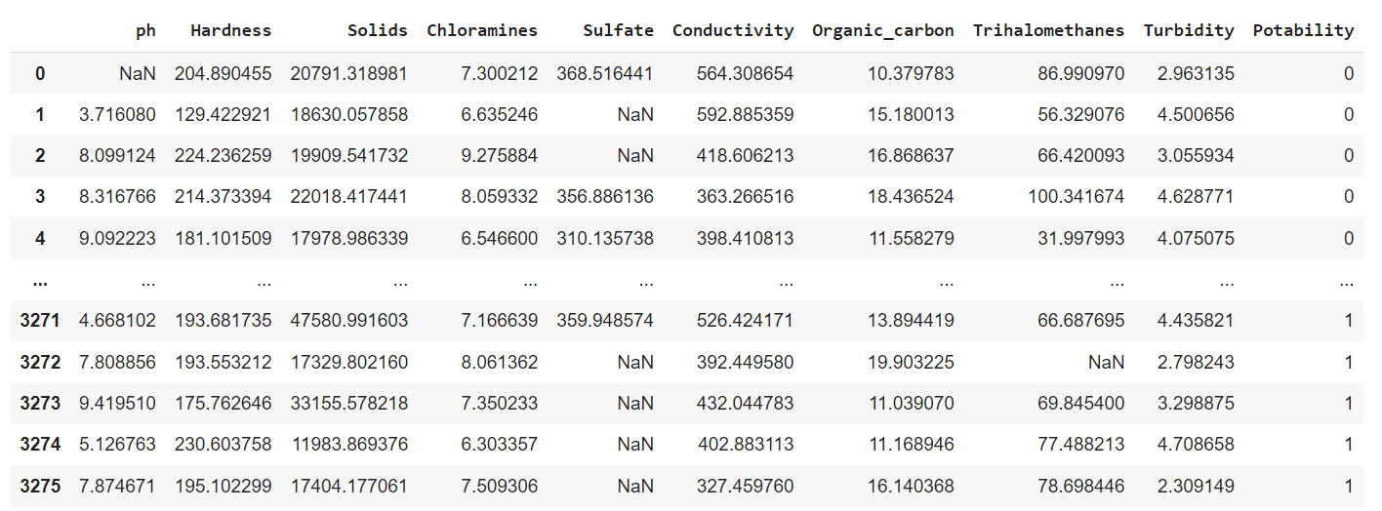
RAW DATA

Slide 9
Exploratory Data Analysis
Exploratory Data Analysis refers to the critical process of performing initial investigations on data so as to discover patterns, to spot anomalies, to test hypothesis and to check assumptions with the help of summary statistics and graphical representations.
Steps performed :
Scaling down for distribution plots
Scatter Matrix
Correlation Matrix
Checking for Missing values
Distribution Plots (with Histograms)

Slide 10
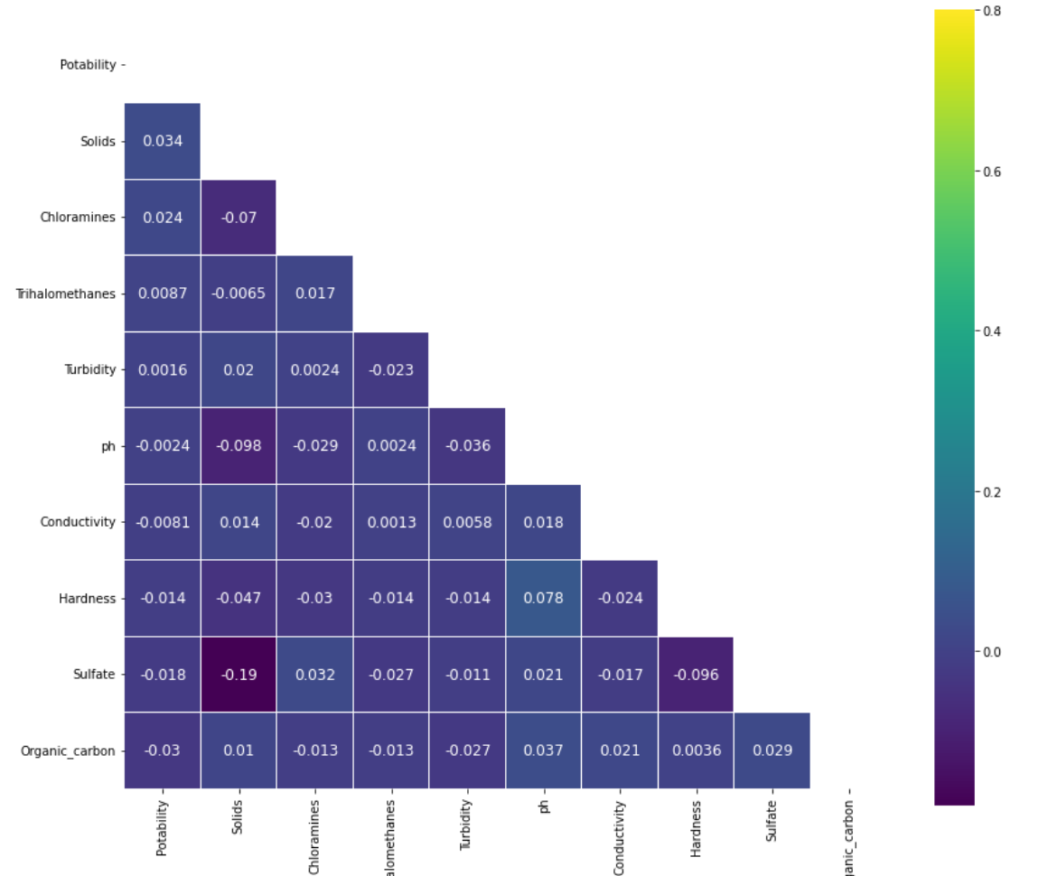
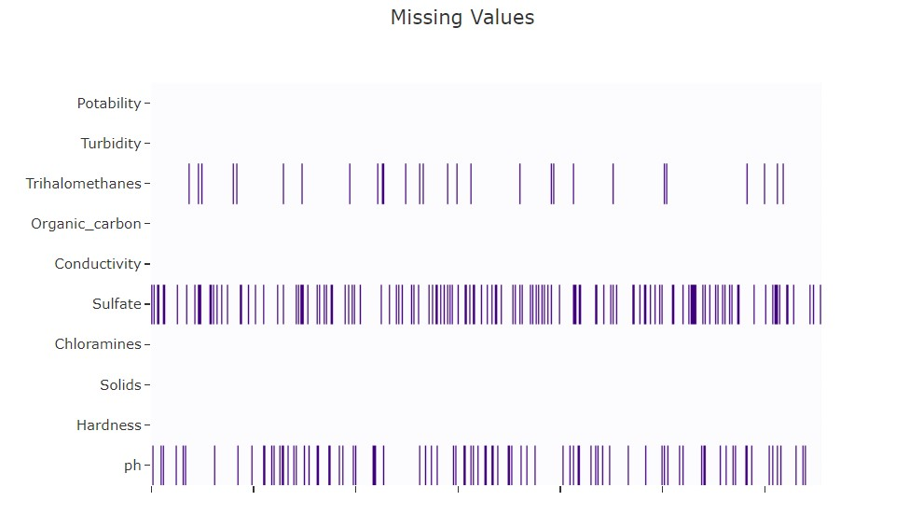
EDA
Correlation Matrix
Checking for missing values

Slide 11
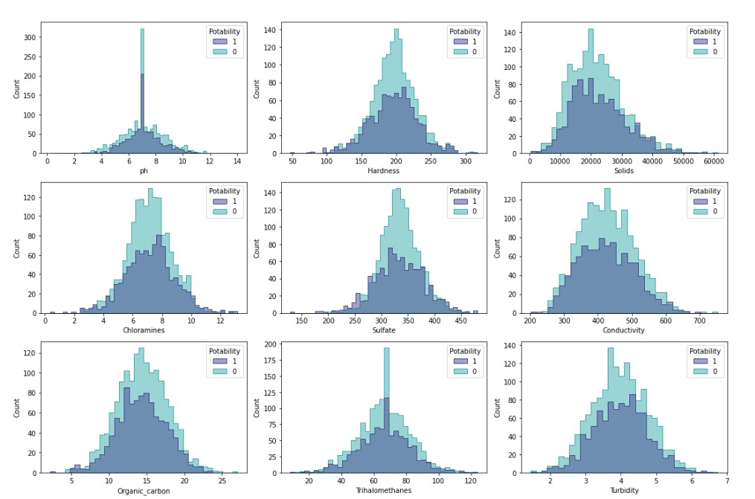
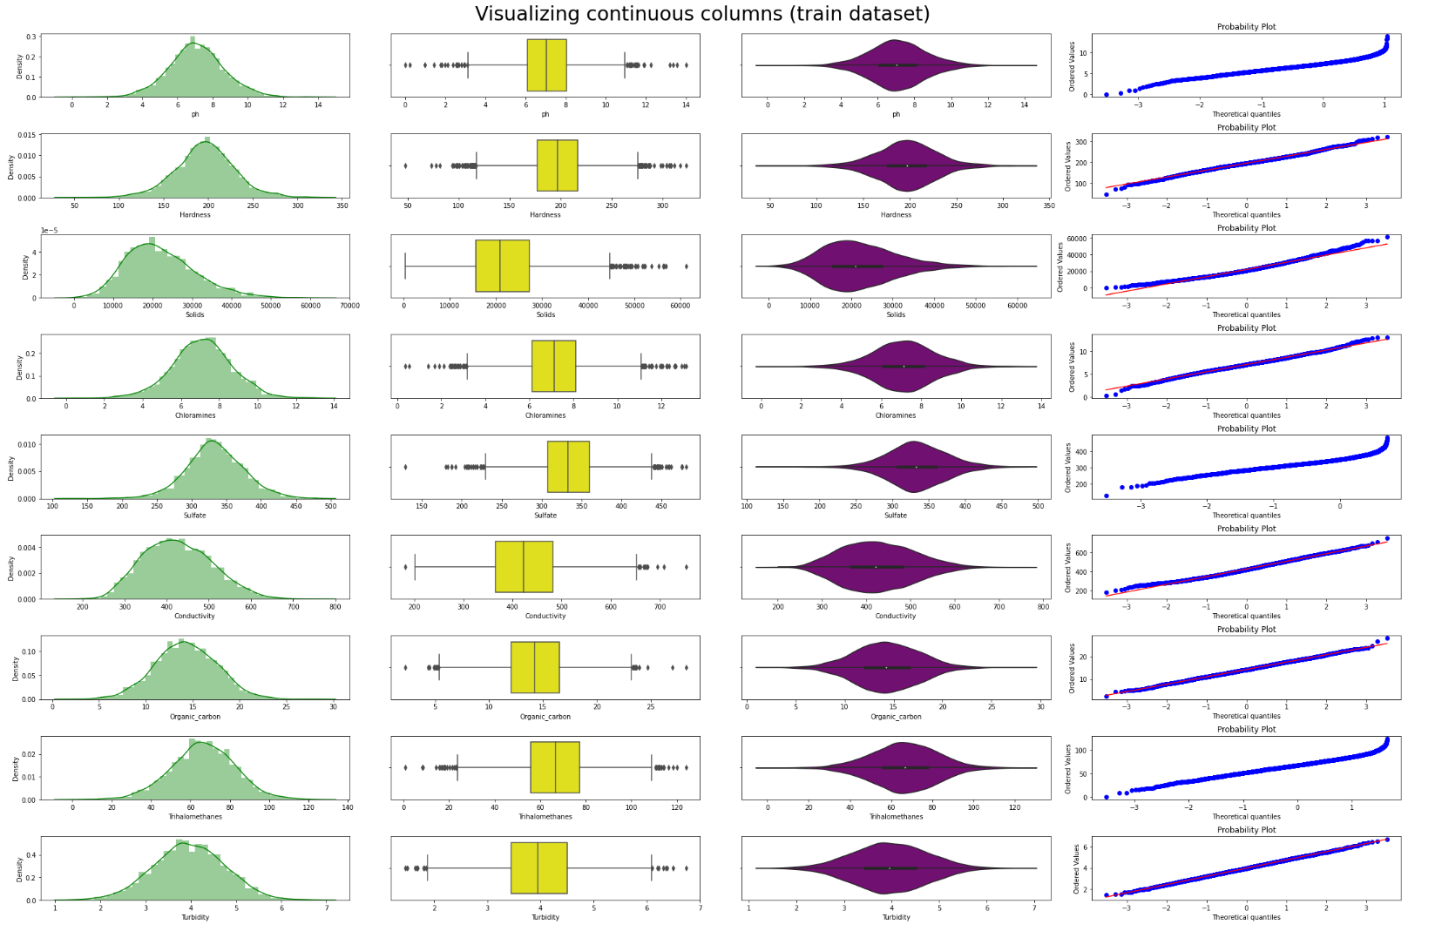
Distribution Plots (Histograms) according to potability
Visualization of continuous features

Slide 12
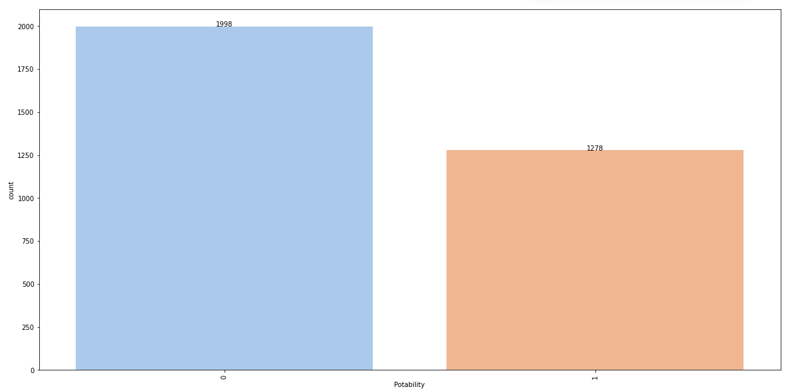
Feature Extraction
Checking the dataset for categorical features
Visualizing continuous features and making hypotheses
Checking the distribution of target feature

Slide 13
4. Creating artificial duplicates to eliminate class imbalance
5. Checking if data is normally distributed
6. Mann-Whitney U-test - rejected the null hypothesis and decided that our final model will include all the features
7. Removing outliers using sklearn’s LocalOutlierFactor
8. Normalizing the data between [0,1]

Slide 14
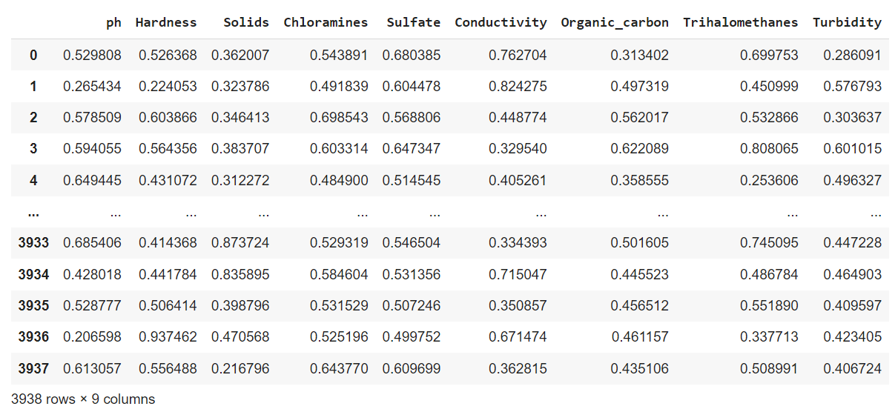
CLEAN DATA

Slide 15
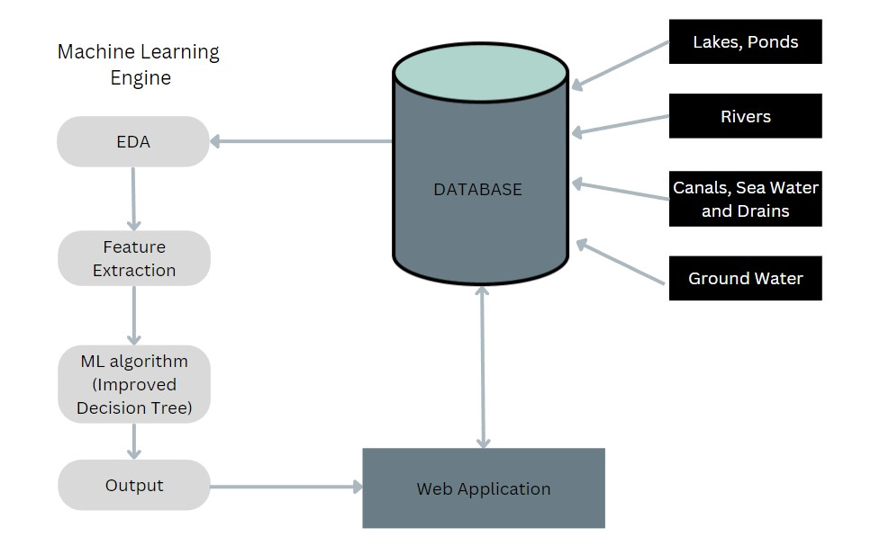
System Architecture

Slide 16
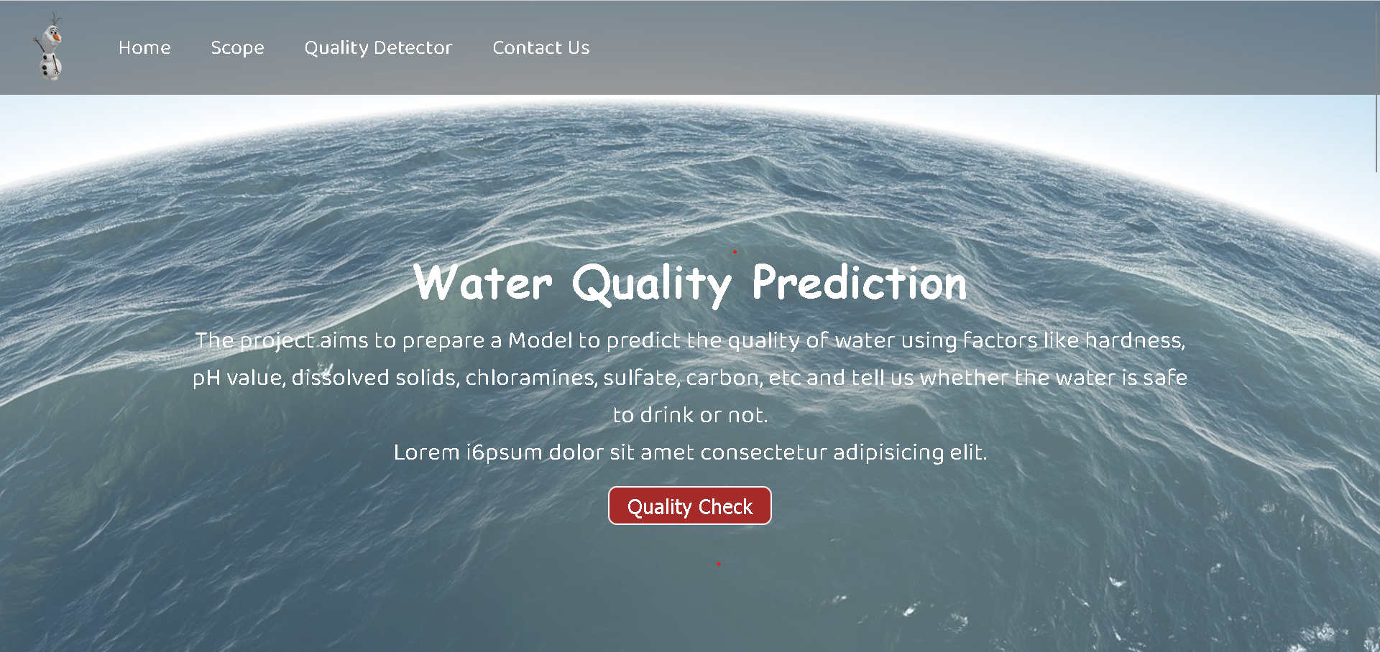
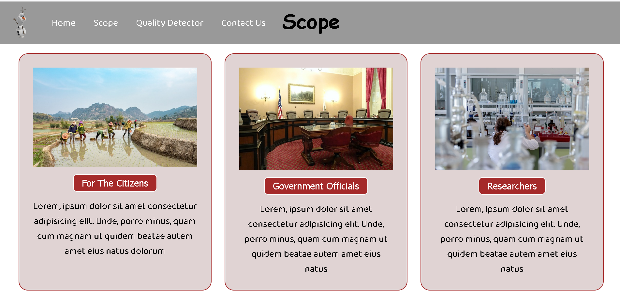
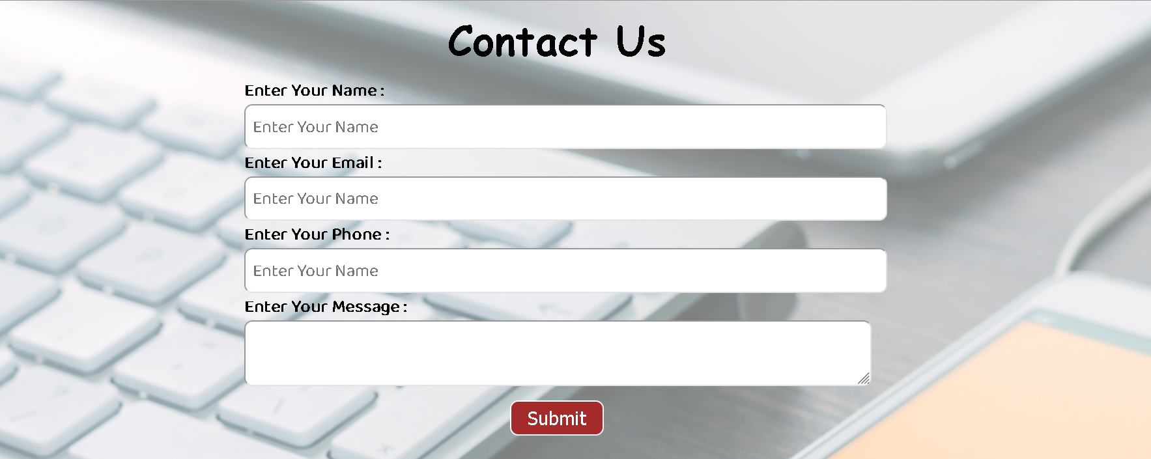
Prototype of our Web Application

Slide 17
Technology Stack
For Machine Learning Model :
Python Libraries - pandas, matplotlib, seaborn
Sklearn - Model Building
For the web application :
Node.js
JavaScript
React
Express.js
Figma for UI/UX visualization.

Slide 18
Conclusion & Future Work
We came to the conclusion of using Improved Decision Tree because
Transparent : gives a clear understanding of which decision is better.
Efficient : Requires little time to create.
Flexible : New ideas or factors can be easily added later.
Future work would consist of
Developing a real time Machine learning model with optimal accuracy
Integrating the model with a web application (React and other supporting technical stack)
Designing and implementing the UI for our web application.
Deploying our web application on a live server.

